Slide 1


Slide 2
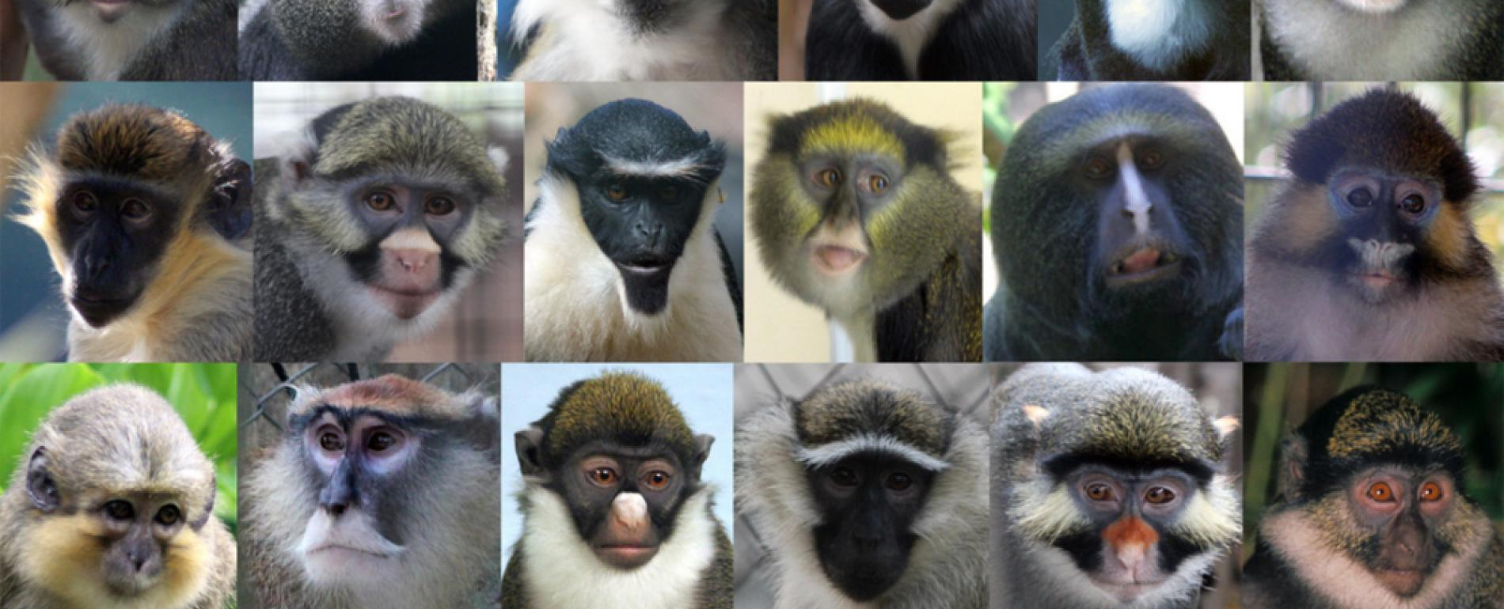
FINE GRAIN IMAGE CLASSIFICATION
Presented by
EMMANUEL MADUWUBA(emaduwub)
KAMALJEET SINGH Mann (kmann52)
DHARANIKOTA RAJENDRA KAMAL(rdharan)

Slide 3
Introduction:-
Machine learning helps us to build analytical models, which in turn help computer in learning from the data.
One such model is used for image classification. It has various applications ranging from identifying the human beings struck In natural calamities to maintaining wild life.
It can be put use to preserving animal species that are nearing extinction.
We have taken a data set that contains the images of monkeys that are segregated into 10 different species.
We are using this data set to apply some fine grain image classification .

Slide 4
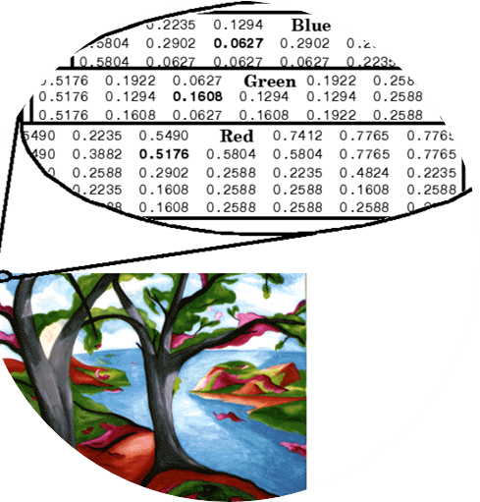
Machine point view of an Image:-
An Image contains pixels and these are stored in the matrix format.
A machine loads matrix of pixel intensities to store the images.
There are monochrome images where the pixels are represented by two intensities only(general term for grayscale Image).
An RGB image has three channels and the pixel of an RGB image is represented as a tuple of numbers([r,g,b]).

Slide 5
Introduction:-
Just like humans learn, artificial neural networks also works in the similar fashion.
Human beings learn by frequently being exposed to the things, feeling them and memorizing their dimensions and can eventually classify them.
In the similar fashion an algorithm can be designed to feed the data for the learning process and then test it weather it classifies correctly or not.
In order to make this learning process more effective and faster we can use feature extraction.

Slide 6

Feature Extraction:-
The perfect way is to understand how each image works and what makes an image or its content different from the other.
For example :- what makes shapes different ?
The way they look , number of side, points , edges etc...

Slide 7
Feature Extraction:-
In the similar way we just have to realize and understand what makes one monkey different from an another.
It can be the color of the monkey or the eyes, the pattern of its skin and facial hair growth or some times even the positioning of the ears.
These features can be extracted by using and determining:-
1. Key points.
2. Gray scaling the image.
3. Using heat map.
4. Edge detection.
5. Setting Boundaries. Etc....

Slide 8
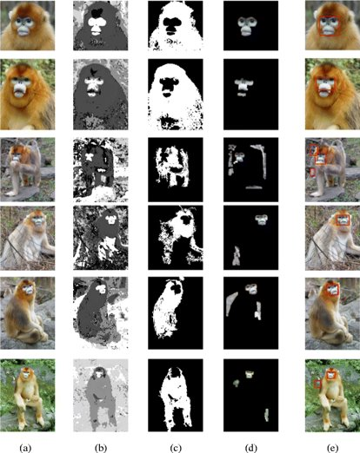
Example:-

Slide 9
DATASET DESCRIPTION
1400 Images
Grouped into subfolders
Over 100+ images
Link : https://www.kaggle.com/slothkong/10-monkey-species

Slide 10

WHY CNN?
One of the best methods for solving prediction problems involving image data as input.
Feature Engineering.
Faster Learning Process

Slide 11

PROJECT PHASES
Problem Analysis
Model Selection
Data Preprocessing
Model Optimization

Slide 12

DATA PREPROCESSING
Flip
Scaling
Resizing

Slide 13
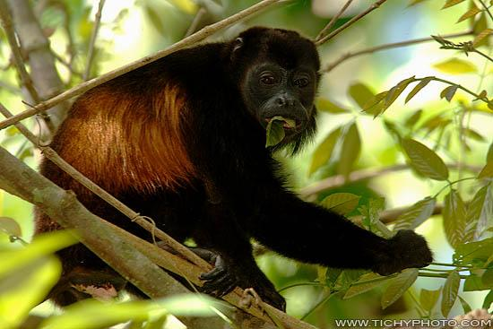
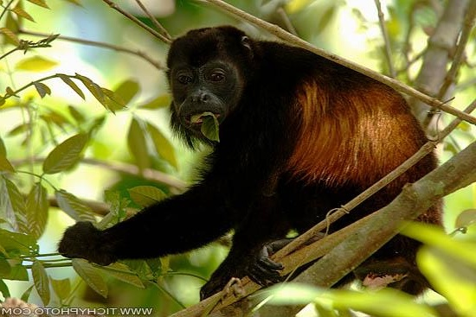
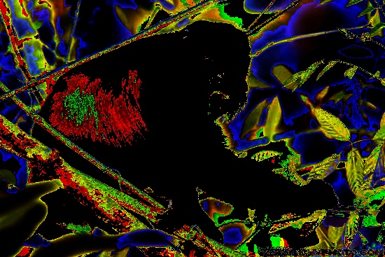
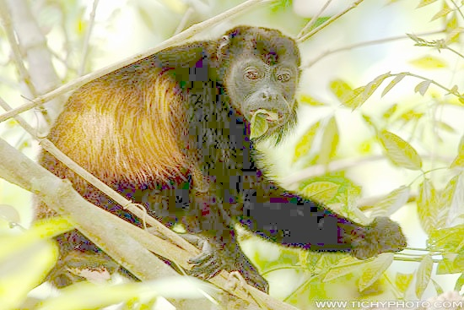
A) Normal image
B) Flipped Image
C) Dark Colour
D) Lightning

Slide 14
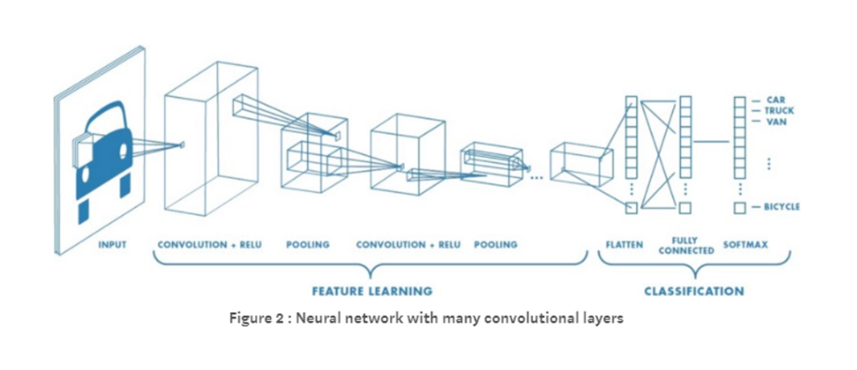
CNN Architecture

Slide 15
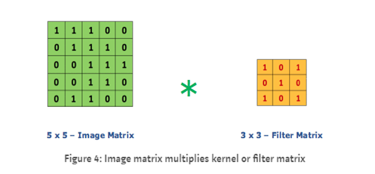
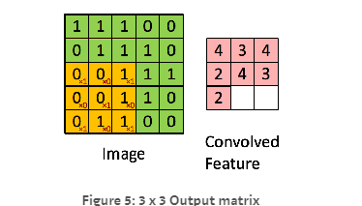
CNN Layer

Slide 16
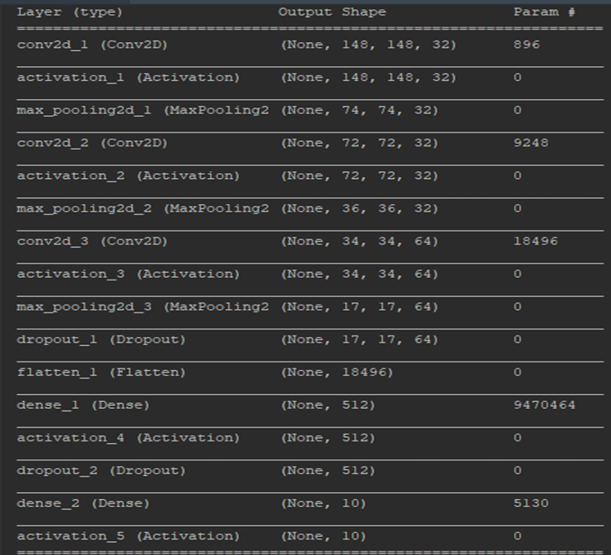
Model Summary

Slide 17
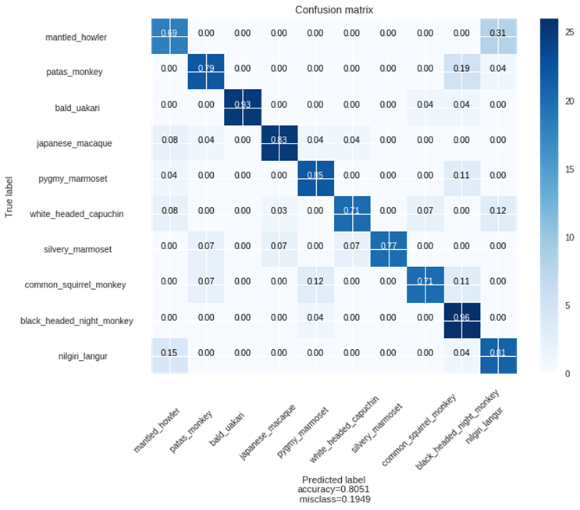
Confusion Matrix

Slide 18
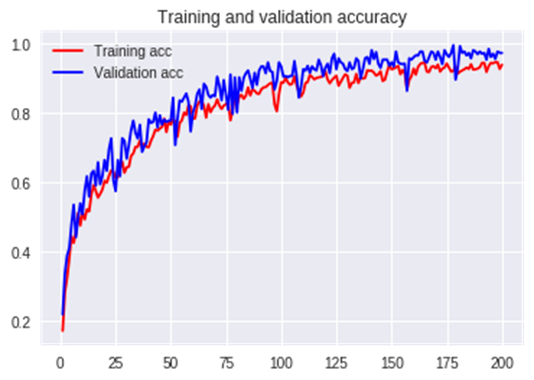
Accuracy

